Slide 1
Clustering and PCA Assignment
VINAY DHARWADKAR

Slide 2
Problem Statement:
HELP International is an international humanitarian NGO that is committed to fighting poverty and providing the people of backward countries with basic amenities and relief during the time of disasters and natural calamities. It runs a lot of operational projects from time to time along with advocacy drives to raise awareness as well as for funding purposes.
After the recent project that included a lot of awareness drives and funding programs, they have been able to raise around $ 10 million. Now the CEO of the NGO needs to decide how to use this money strategically and effectively. The significant issues that come while making this decision are mostly related to choosing the countries that are in the direst need of aid.
Business Goals:
Categorize the countries using some socio-economic and health factors that determine the overall development of the country.
Suggest the countries which the CEO needs to focus on the most.

Slide 3
Analysis Approach
Import data and pre-processing
Standardization of various numerical attributes
Principal Component Analysis (PCA)
Outlier Detection
K-Means Clustering for varying number of clusters.
Hierarchical Clustering for varying number of clusters.
Determine optimum Clustering Technique and Number of Clusters.
Outlier Handling
Recommendations

Slide 4
1. Import data and pre-processing
Data is imported into Python Pandas Dataframes.
Checks for duplicate entries, columns with null values(empty) were done and no abnormalities were found with the data.
The attributes ‘Health Expenditure’(health), ‘Exports’ (exports)and ‘Imports’ (imports) have been represented as percentage of ‘Total GDP’. However, data has ‘Total GDP per Capita’ (gdpp).
The attributes ‘Health Expenditure’(health), ‘Exports’ (exports)and ‘Imports’ (imports) have been converted so as to represent these values per capita instead of percentage of ‘Total GDP’.
This was done by multiplying the attribute with ‘Total GDP’ value and dividing by 100.
Ex: ‘Health Expense per capita’ = (‘Health Expenditure as %age of Total GDP’ ) * (‘Total GDP’)
------------------------------------------------------------------------------
100

Slide 5
2. Standardization of various numerical attributes
Attributes present in the data are : ‘Country Name', 'Child Mortality Rate’, ‘Exports per Capita’, ‘Health Expense per Capita’, ‘Imports per Capita’, ‘Income per person’, ‘Inflation’, ‘Life Expectancy’, ‘Total Fertility’ and ‘Total GDP per Capita’.
The attributes have a varying range from a few units to a few thousand units. The PCA and Clustering models are sensitive to scale of the attributes and hence the need for standardization of data.
All the numeric attributes have been standardized using #StandardScaler Method.
#Standard Scaler : Standardize features by removing the mean and scaling to unit variance
The standard score of a sample x is calculated as: z = (x - u) / s
where u is the mean of the training and s is the standard deviation of the training.

Slide 6
Principal Component Analysis (PCA)
PCA is a dimensionality reduction technique where the original features are reduced to lesser number of Principal Components without losing much of the variation present in the Data
An initial PCA model was run using all the numeric attributes of the data to generate equal number of principal components.
Since the original data has 9 Numeric attributes, the initial PCA generated 9 Principal Components.
Hopkins test conducted on the original attributes gave a score of ~0.95 indicating high tendency for clustering the data.
The correlation between all the principal components is found to be close to zero, indicating orthogonality of the principal components. The first three principal components explain a cumulative variance of ~87% leading to reducing the number of components from 9 to 3.

Slide 7
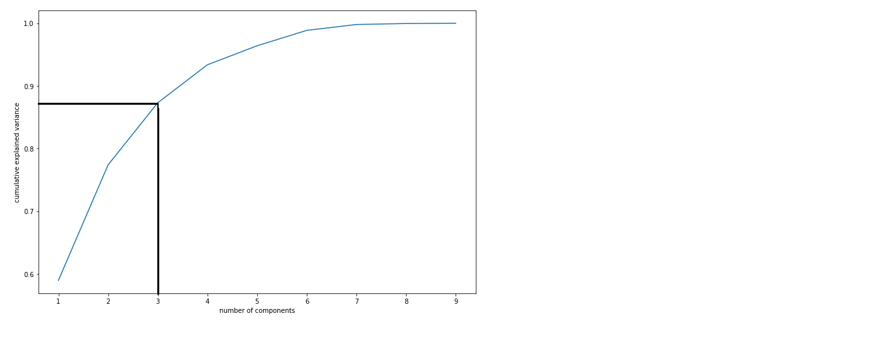
Principal Component Analysis (PCA) contd.
Scree-Plot shows the cumulative variance explained by each of the principal components to plot the number of principal components against the cumulative variance explained. 3 Principal components are able to explain a cumulative variance of ~87%.
A new PCA Model is built to generate 3 Principal components which will be used for further analysis.

Slide 8
Outlier Detection and Removal
The Clustering Models are sensitive to Outlier Data and may result in creation of sub-optimal cluster thereby reducing the purpose of clustering.
Outlier Detection is done on the 3 Principal Components using the ‘Inter-Quartile Range Method’ where in any data point lying beyond (Q1 - 1.5*IQR) and (Q3 + 1.5*IQR) are assumed to be outliers and removed
where Q1 = First Quartile(25 Percentile)
Q3 = Third Quartile(75 Percentile)
IQR = Q3 – Q1
Data related 18 countries were identified as Outliers and removed.
These 18 Countries will be assigned back to appropriate Clusters at the end of the Clustering Process.

Slide 9
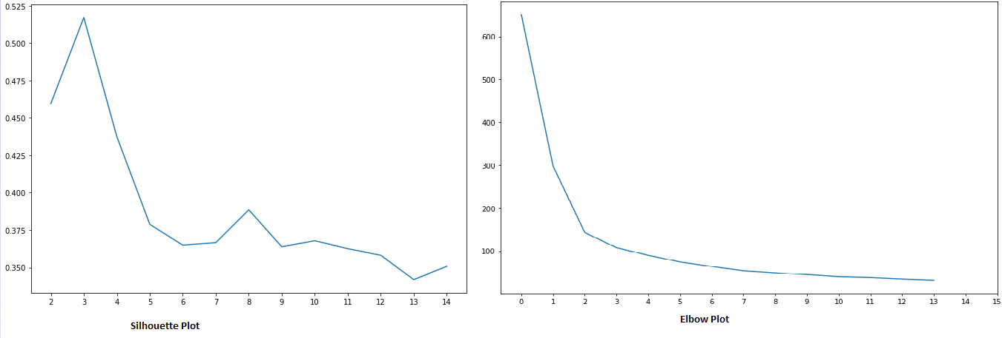
K-Means Clustering for varying number of clusters.
Silhouette Plot and Elbow Plot drawn to determine the number of optimum number of clusters.
Optimum number of clusters could be either 3 or 4.

Slide 10
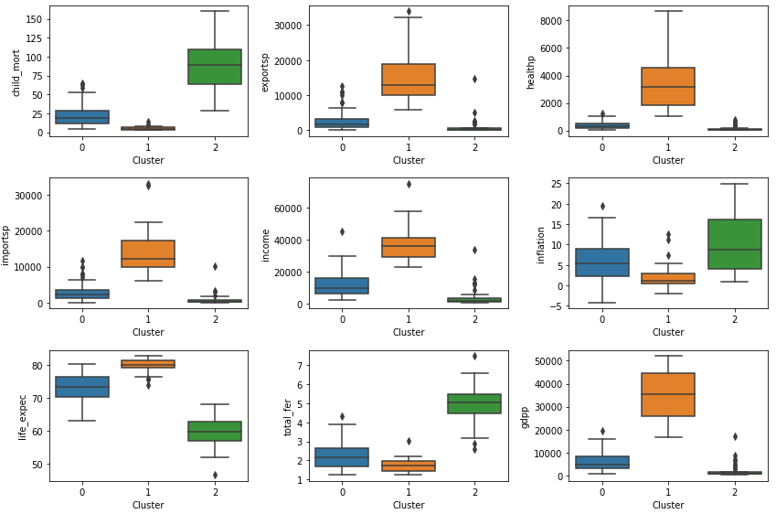
K-Means 3-Clusters
Clusters formed had the break-up: Cluster0 = 77 Countries, Cluster1 = 28 Countries and Cluster2= 44 Countries.
Box-plot to analyse original features using the clusters created

Slide 11
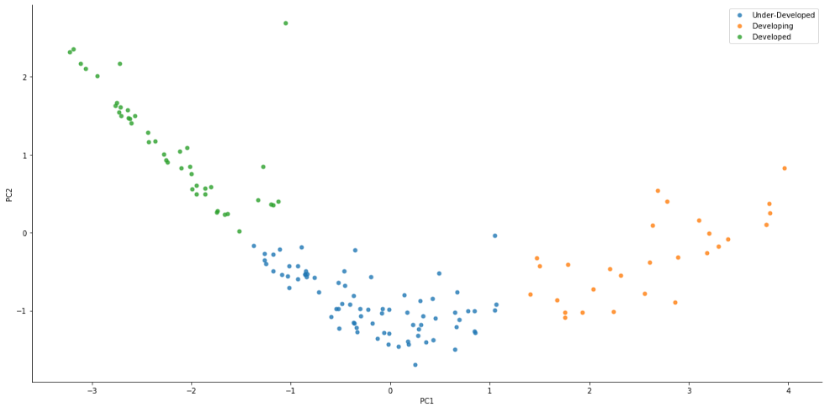
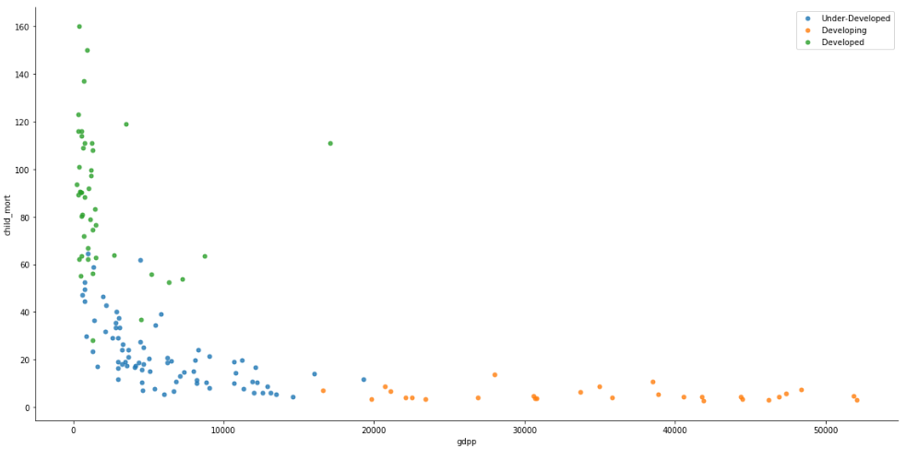
K-Means 3-Clusters contd.
Major attributes influencing the clusters are : GDPP, Child Mortality Rate, Inflation. Backward(Low GDPP, High Child Mortality, High Inflation)
Developing(Moderate GDPP, Moderate Child Mortality, Moderate Inflation)
Developed(High GDPP, Low Child Mortality, Low Inflation)
A scatter plot of the Principal Components and some of the original features captures this categorization.

Slide 12
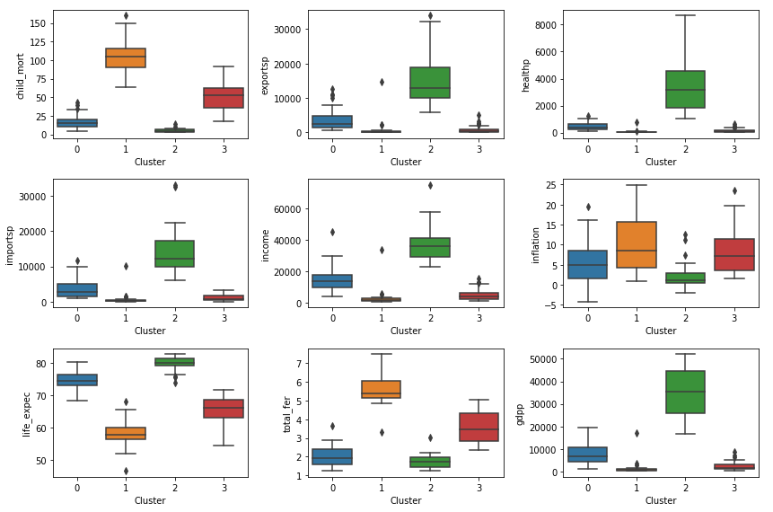
K-Means 4-Clusters
Clusters formed had the break-up: Cluster0 = 57 Countries, Cluster1 = 26 Countries , Cluster2= 28 Countries and Cluster3= 38 Countries.
Box-plot to analyse original features using the clusters created

Slide 13
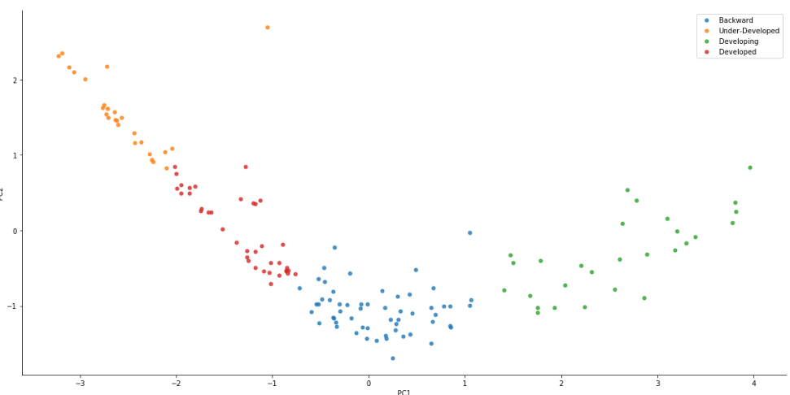
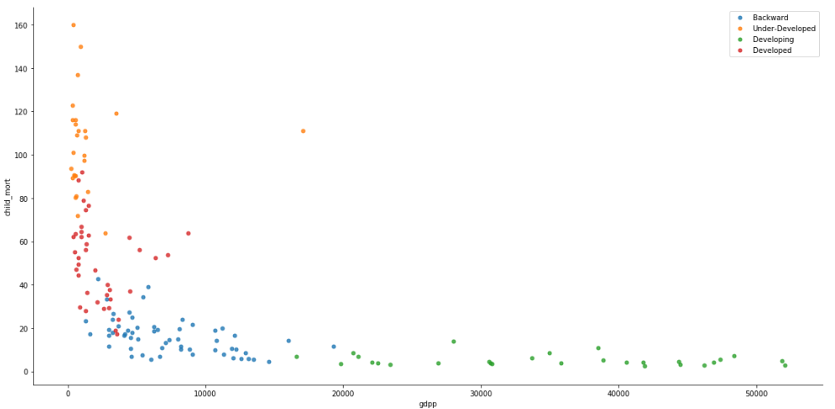
K-Means 4-Clusters contd.
Major attributes influencing the clusters are : GDPP, Child Mortality Rate, Inflation. Backward(Low GDPP, High Child Mortality, High Inflation)
Under-Developed(Moderately Low GDPP, Moderately High Child Mortality, Moderately High Inflation)
Developing(Moderate GDPP, Moderate Child Mortality, Moderate Inflation)
Developed(High GDPP, Low Child Mortality, Low Inflation)
A scatter plot of the Principal Components and some of the original features captures this categorization.

Slide 14
K-Means Model Finalization
Since we have a reduced number of Backward countries in the K=4 K-Means Clustering, it give the organization a smaller list of countries to concentrate the aid distribution. Hence we can go with K=4 K-Means Clustering Model for final evaluation with Hierarchical Model.
Country Listed as Backward and in need of aid:
'Afghanistan', 'Angola', 'Benin', 'Burkina Faso', 'Burundi', 'Cameroon', 'Chad', 'Congo, Dem. Rep.', 'Congo, Rep.', "Cote d'Ivoire", 'Equatorial Guinea', 'Gambia', 'Guinea', 'Guinea-Bissau', 'Lesotho', 'Liberia', 'Malawi', 'Mali', 'Mauritania', 'Mozambique', 'Niger', 'Sierra Leone', 'Tanzania', 'Togo', 'Uganda', 'Zambia'

Slide 15
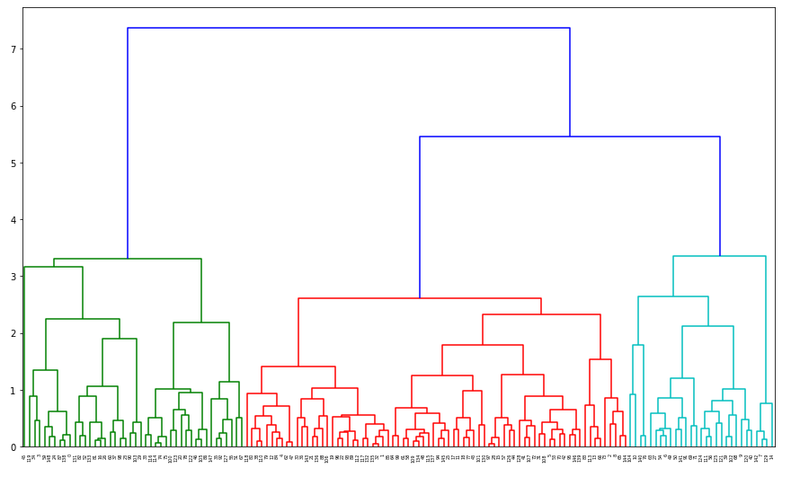
Hierarchical Clustering
Dendogram Plot of the non-outlier countries :
Intuitively either 3 or 4 Clusters can be formed.

Slide 16
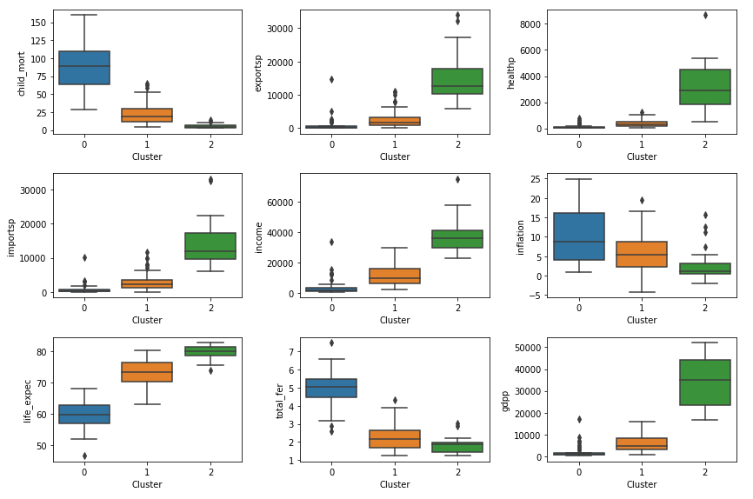
Hierarchical 3-Clusters
Clusters formed had the break-up: Cluster0 = 44 Countries, Cluster1 = 76 Countries and Cluster2= 29 Countries.
Box-plot to analyse original features using the clusters created

Slide 17
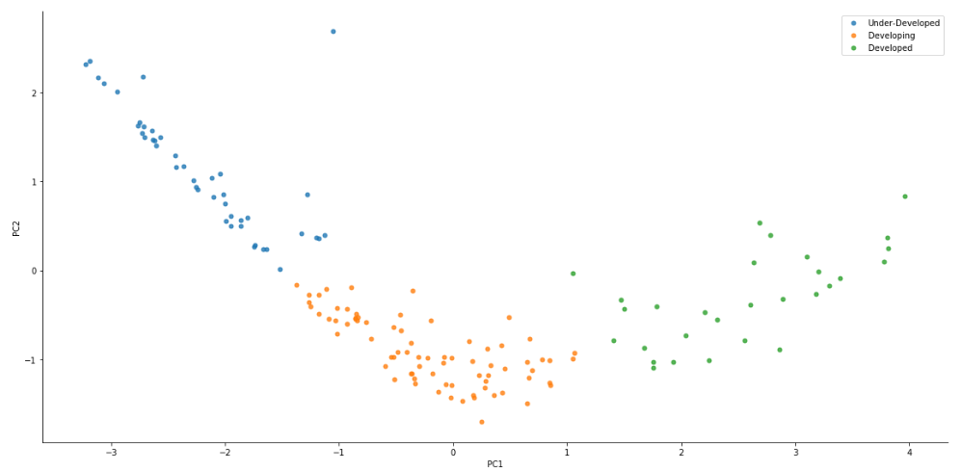
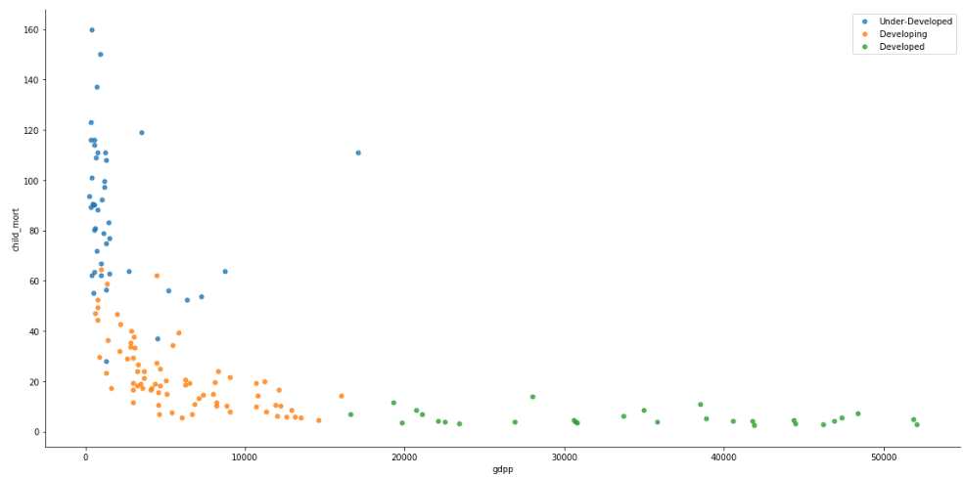
Hierarchical 3-Clusters contd.
Major attributes influencing the clusters are : GDPP, Child Mortality Rate, Inflation. Backward(Low GDPP, High Child Mortality, High Inflation)
Developing(Moderate GDPP, Moderate Child Mortality, Moderate Inflation)
Developed(High GDPP, Low Child Mortality, Low Inflation)
A scatter plot of the Principal Components and some of the original features captures this categorization.

Slide 18
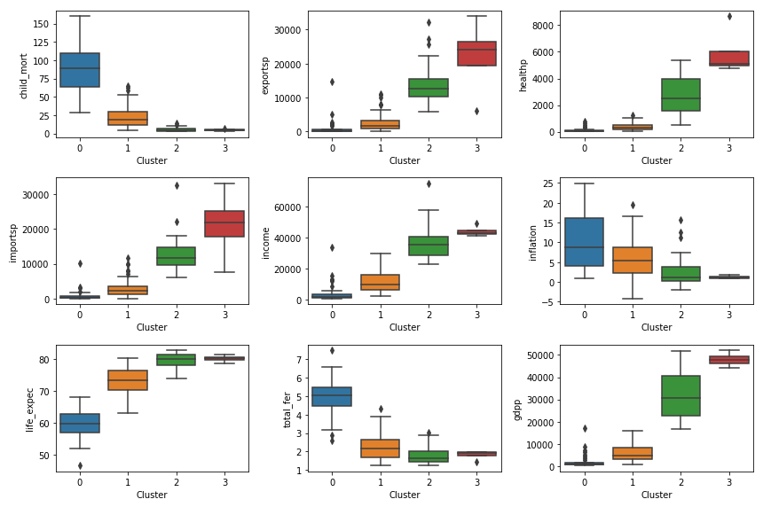
Hierarchical 4-Clusters
Clusters formed had the break-up: Cluster0 = 44 Countries, Cluster1 = 76 Countries , Cluster2= 25 Countries and Cluster3= 4 Countries.
Box-plot to analyse original features using the clusters created

Slide 19
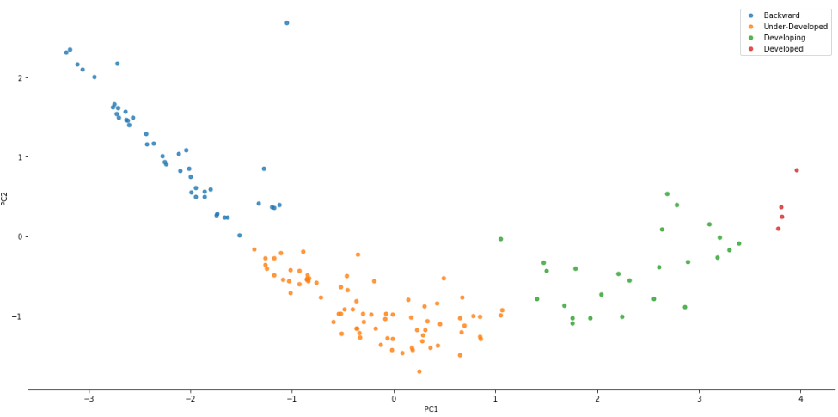
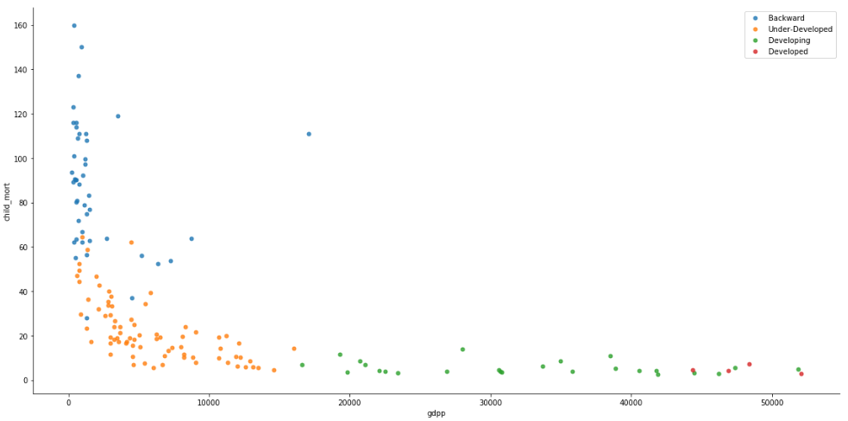
Hierarchical 4-Clusters contd.
Major attributes influencing the clusters are : GDPP, Child Mortality Rate, Inflation. Backward(Low GDPP, High Child Mortality, High Inflation)
Under-Developed(Moderately Low GDPP, Moderately High Child Mortality, Moderately High Inflation)
Developing(Moderate GDPP, Moderate Child Mortality, Moderate Inflation)
Developed(High GDPP, Low Child Mortality, Low Inflation)
A scatter plot of the Principal Components and some of the original features captures this categorization.

Slide 20
Hierarchical Model Finalization
The number of Backward countries is the same in both models.
The clusters are more spread in Hierarchical 4-Clusters and hence we can choose this for final evaluation with K-Means
Country Listed as Backward and in need of aid:
'Afghanistan', 'Angola', 'Benin', 'Botswana', 'Burkina Faso', 'Burundi', 'Cameroon', 'Chad', 'Comoros', 'Congo, Dem. Rep.', 'Congo, Rep.', "Cote d'Ivoire", 'Equatorial Guinea', 'Eritrea', 'Gabon', 'Gambia', 'Ghana', 'Guinea', 'Guinea-Bissau', 'Iraq', 'Kenya', 'Kiribati', 'Lao', 'Lesotho', 'Liberia', 'Madagascar', 'Malawi', 'Mali', 'Mauritania', 'Mozambique', 'Namibia', 'Niger', 'Pakistan', 'Rwanda', 'Senegal', 'Sierra Leone', 'Solomon Islands', 'South Africa', 'Sudan', 'Tanzania', 'Togo', 'Uganda', 'Yemen', 'Zambia'

Slide 21
Final Model Selection
The K-Means 4-Cluster Model has a total of 26 countries marked as Backward where as Hierarchical 4-Clusters Model has 44 Countries.
All the countries marked as Backward in K-Means 4-Cluster model are also part of the Backward Country list in Hierarchical 4-Cluster model
The spread of clusters is more even in K-Means 4-Cluster model as compared to Hierarchical 4-Clusters Model
Hence, the final model chosen for clustering is K-Means 4-Cluster model .

Slide 22
Outlier Handling
The Countries which where removed from clustering process due to extreme values in some of their attributes were fit into the final Clusters formed by the K-Means 4-Cluster Model.
Final Clusters and their counts are:
List of countries in Backward Country Category:
'Afghanistan', 'Angola', 'Benin', 'Burkina Faso', 'Burundi', 'Cameroon', 'Central African Republic', 'Chad', 'Congo, Dem. Rep.', 'Congo, Rep.', "Cote d'Ivoire", 'Equatorial Guinea', 'Gambia', 'Guinea', 'Guinea-Bissau', 'Haiti', 'Lesotho', 'Liberia', 'Malawi', 'Mali', 'Mauritania', 'Mozambique', 'Niger', 'Nigeria', 'Sierra Leone', 'Tanzania', 'Timor-Leste', 'Togo', 'Uganda', 'Zambia'
Category | Cluster Number | Count
Backward | 1 | 30
Under-Developed | 3 | 39
Developing | 0 | 61
Developed | 2 | 37

Slide 23
Recommendations
The 30 Countries marked as Backward Countries are in dire need of aid.
Aid can be prioritised based on the Socio-Economic factors in the following sequence:
Low GDPP, High Child Mortality, High Inflation
Additional aid if available can be then given to countries in the Under-Developed Category again prioritised by he same factors.
THANK YOU

